Slide 1
UNIT - III
Disaster Impacts - Disaster impacts (environmental, physical, social, ecological, economic, political, etc.);
health, psycho-social issues;
demographic aspects (gender, age, special needs);
hazard locations;
global and national disaster trends;
climate change and urban disasters.

Slide 2
Disaster Impacts
Disaster impacts
environmental
physical
social
ecological
economic
political
health
psycho-social issues
demographic aspects
gender, age, special needs
hazard locations
global and national disaster trends
climate change
urban disasters

Slide 3
Disaster Impacts
Disaster impacts
There are the physical and social disturbances that a hazard agent inflicts when it strikes a community,
physical impacts comprise causalities, (deaths, injuries & illnesses) and damage to agriculture structures, infrastructure and the natural environment.
Social impacts comprise psychological impacts demographic impacts, economic impacts & political impacts

Slide 4
Environmental Impacts
Physical Impacts
Water
Land/soil
Land-use
Landscape
Crops
Lake/rivers
Aquaculture
Forests
Animals/livestock
Wildfire
Atmosphere
energy
Injuries
Death
Physical disability
Burns
Epidemics
Weakness/uneasiness
Physical illness
Sanitation
Miscarriage
Reproductive health
Loss of sleep
Fatigue

Slide 5
Social Impacts
Economical Impacts
Loss of life
Change in individual’s role
Disruption of social fabric
Isolation
Change in marital status
Sexual abuse & domestic violence
Orphans
Single parent children
Family & social disorganization
Migration
Life style changes
Breakdown of traditional social status
Unemployment
Loss of livelihood
Loss of property/ land
Loss of household articles
Loss of crops
Loss of public infrastructure

Slide 6
Political Impacts
Ecological Impacts
Political disruption
Imbalance in the country
Riots
Formation of lakes and mountains
Destruction of roads,
Buildings
Infrastructure
Damage to dams
Loss of life of aquatic life
Loss of wild life
Loss of vegetation

Slide 7
Health
Epidemic is an outbreak of a contractible disease that spreads through a human population.
A pandemic is an epidemic whose spread is global
There have been many epidemics through out history, such as black death.
In the last hundred years significant pandemics include
1918 spanish flu 50million people lost life
1957-58 Asian flue 1million people lost life
1968-69 hongkong water flu
2002-03 SARS pandemic
1959 beginning of HIV – AIDS
2009-10 H1N1 (Swine Flue)
2019 COVID-19

Slide 8
Psycho-Social Issues
Demographic Aspects
Post traumatic symptoms
Depression
Anxiety
Dissociation
Suicidality
Dissocial behavior
Substance abuse were common
Impaired balance
Decreased strength
Poor exercise tolerance
Difficulty in evacuation
Difficulty in protection
Difficulty in getting access to relief and compensation money
Difficulty location avenues of escape

Slide 9
Hazardous location
Locations consists of areas with high potential for fire or explosion accidents
due to electrical equipment
Flammable or ignitable gases, liquids, vapours
Combustible dusts, fibers
Explosion proof equipment arises due to this potential
Guideline for fire safety was given by
NATIONAL ELECTRIC CODE (NEC)
NATIONAL FIRE PROTECTION ASSOCIATION (NFPA)
UNDERWRITERS LABORATORIES (UL)

Slide 10
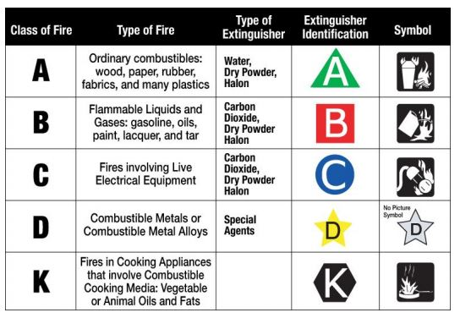
Hazardous location
3 fire extinguishers are used in the form of triangle to put out the fire

Slide 11
Global & national disaster trends
Development & relief agencies have long recognized the important role played by data and information in mitigating the impacts of disasters on vulnerable population
Systematic collection and analysis of these data provides invaluable information to governments and agencies in charge of relief and recovery activities
It also aids the integration of health components in development and poverty alleviation programs
However there is a lack of international consensus regarding best practices for collecting these data
Together with the complexity of collecting reliable information, there remains huge variability in definitions, methodologies, tools and sourcing
CRED has a long history of standardized data compilation, validation and analysis
It provides free and open access to its data through its website

Slide 12
One of CRED’s core data products is EM-DAT the International disaster data
EM-DAT provides an objective basis vulnerability assessment and rational decision-making in disaster situations
For example – it helps policy makers identify disaster types that are most common in a given country and have had significant historical impacts on specific human populations
In additional to providing information on the human impacts of disaster such as the number of people killed, injured or affected EM-DAT provides disaster related economic damage estimates and disaster specific international aid contributions

Slide 13
CLIMATE CHANGE
Climate change is a phrase that is essentially self explanatory,, it is the change in the climate of a country, region or the world over and is believed to be caused either directly or indirectly by the activity of the human race
They type of climate we experience now might be prevailing over the last 1000 yrs with minor and occasionally wide fluctuations.
The planet earth has witnessed many variations in climate since the beginning
Geological records show alternation of glaciers and inter glacial periods
The geomorphological gestures, especially in high altitudes, exhibit traces of advances and retreats of glaciers.
The sediment deposits in glacial lakes also reveal the occurance of warm and cold periods
The rings in the trees also provide clues about we & dry periods
Historical records describe the vagaries in climate
All these evidences indicate that change in climate is a natural and continuous process

Slide 14
CLIMATE CHANGE
Climate change is a phrase that is essentially self explanatory,, it is the change in the climate of a country, region or the world over and is believed to be caused either directly or indirectly by the activity of the human race
They type of climate we experience now might be prevailing over the last 1000 yrs with minor and occasionally wide fluctuations.
The planet earth has witnessed many variations in climate since the beginning
Geological records show alternation of glaciers and inter glacial periods
The geomorphological gestures, especially in high altitudes, exhibit traces of advances and retreats of glaciers.
The sediment deposits in glacial lakes also reveal the occurance of warm and cold periods
The rings in the trees also provide clues about we & dry periods
Historical records describe the vagaries in climate
All these evidences indicate that change in climate is a natural and continuous process

Slide 15
India also witnessed alternate wet & dry periods
Archaeological findings show that Rajasthan desert experienced wet and cold climate around 8,000 BC
The period 3000 to 1700 BC had higher rainfall
From 2000 to 1700 BC this region was the centre of Harapan civilisation

Slide 16
Climate in recent past
Variability in climate occurs all the time
The nineties decade of the last century witnessed extreme weather events.
The 1990’s recorded the warmest temperatures of the century & some of the worst floods around the world
The worst devastating drought in the Sahel region, south of Sahara desert from 1967-77 is one such variability
During the 1930’s severe drought occurred
Great plains of the united states, described as the dust bowl
Historical records of crop yield or crop failures of floods and migration of people tell about the effects of changing climate

Slide 17
CAUSES OF CLIMATE CHANGE
Climate refers to the long term average of the aggregation of all components of weather precipitation temperature and cloudiness
The climate system includes processes involving ocean, land and sea ice in addition to the atmosphere
The earth system encompasses the climate system
Many changes in earth system functioning directly involve changes in climate
However the earth system includes other components and processes, biophysical and human those are important for its functioning.
Some earth system changes, natural or driven by humans, can have significant consequences without involving changes in climate
Global change should not be confused with climate change
It is significantly more indeed, climate change is part of this much larger challange

Slide 18
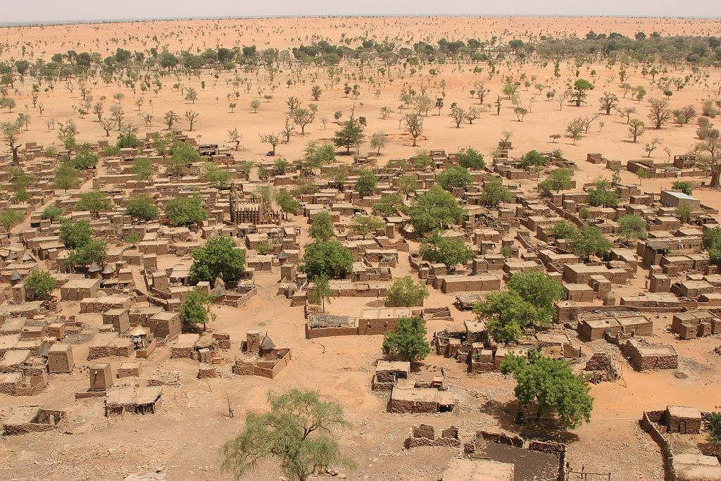
Environmental migration. Sparser rainfall leads to desertification that harms agriculture and can displace populations.

Slide 19
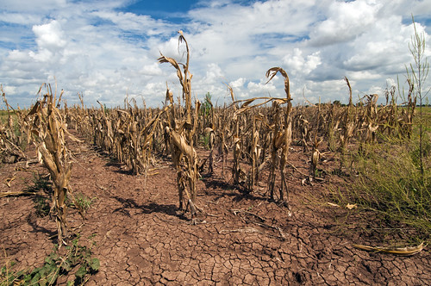
Agricultural changes. Droughts, rising temperatures, and extreme weather negatively impact agriculture.

Slide 20
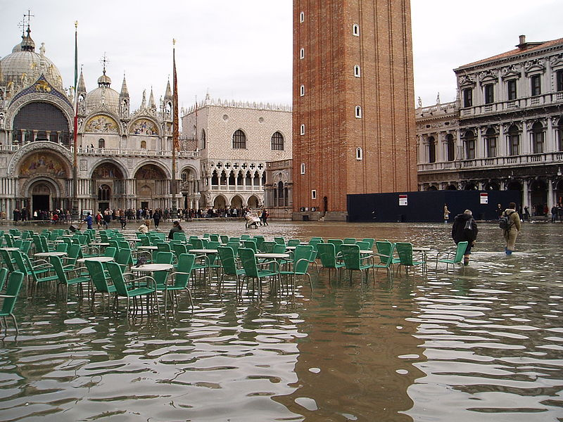
Tidal flooding. Sea-level rise increases flooding in low-lying coastal regions. Shown: Venice, Italy.

Slide 21
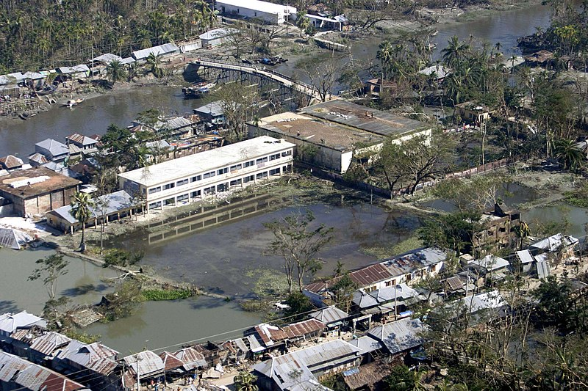
Storm intensification. Bangladesh after Cyclone Sidr is an example of catastrophic flooding from increased rainfall.

Slide 22
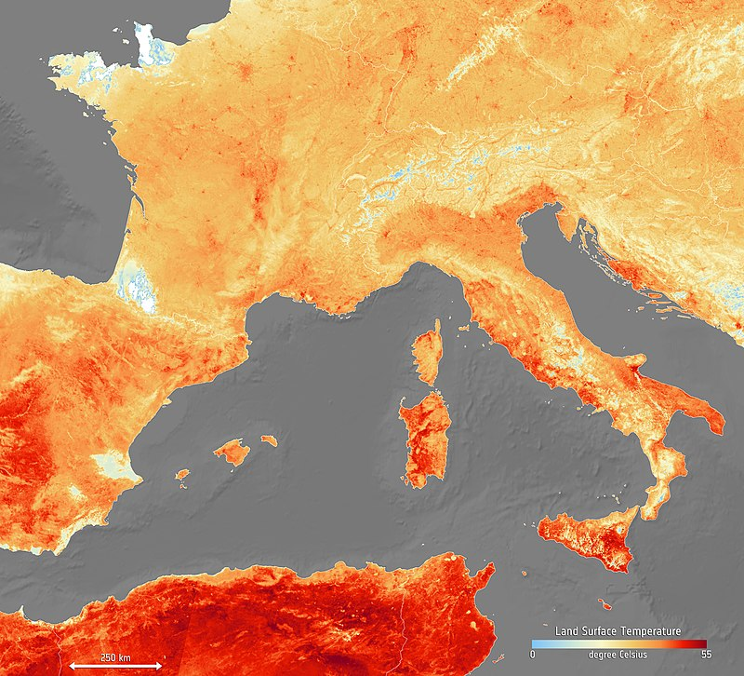
Heat wave intensification. Events like the June 2019 European heat wave are becoming more common.

Slide 23
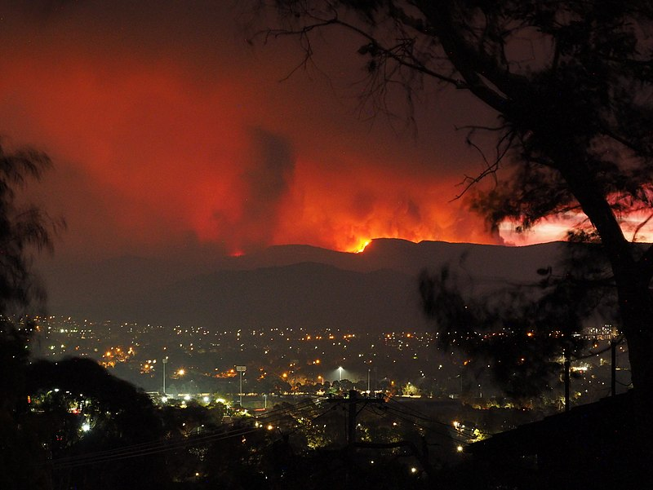
Extreme weather. Drought and high temperatures worsened the 2020 bushfires in Australia.

Slide 24
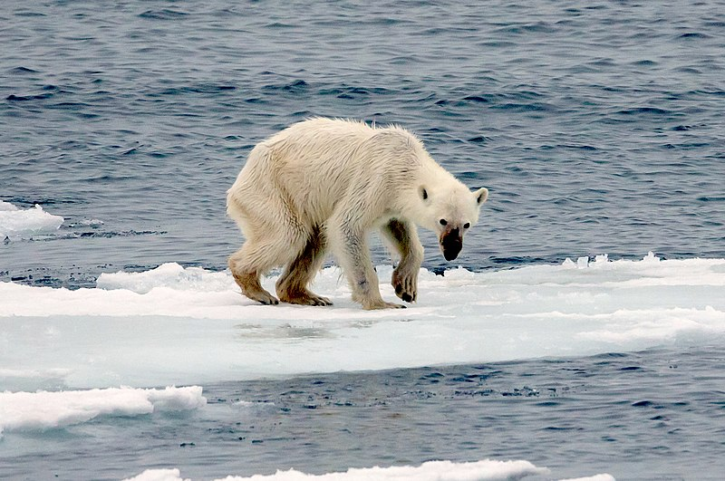
Habitat destruction. Many arctic animals rely on sea ice, which has been disappearing in a warming Arctic.

Slide 25
Urban disasters
When disasters affect cities or urban areas (non rural contexts) they are referred to as urban disasters
Recently, torrential rains that took place in Hyderabad have caused massive urban floods. In many Indian cities, the urban floods have become a frequent phenomenon in recent years. As the incidence of climate variability and extreme weather events increases, urban flooding becomes more and more common.

Slide 26
Impact of urban disasters
Human life
Destruction of buildings & infrastructure
Water contamination
Disorganization of services & economic activity
Damage of economic facilities( factories, storage, agriculture etc.,)

Slide 27
Who is most vulnerable?
When a city starts flooding after intense rainfall, the focus is on the breakdown of public services, the closing of schools, and difficulty in transportation, among others.
While these problems bring the city to a halt and make news for a few days, what is missed is the focus on who gets worst hit and how?
Mumbai, for instance, is often referred as a prime example when it comes to discussing urban floods in India.
A United Nations Habitat paper on monsoon floods in Mumbai mentions that even after 10 days of intense rainfall, the suburban and low-lying areas near the Mithi river remain waterlogged without services, appropriate shelter, potable water or food.
This area is estimated to have 70 per cent occupancy by slums and pavement dwellers, including one of the largest slums in the world — Dharavi.
In any city, the low-lying regions like nallahs, railway lines, roads and highways — where squatter settlements pop-up — are the areas, which are most prone to flooding. Built uninformedly and with makeshift materials, many people lose their residence with recurring floods, which never gets accounted for.

Slide 28
Causes :
Inadequate Drainage Infrastructure: Cities like Hyderabad, Mumbai rely on a century-old drainage system, covering only a small part of the core city.
In the last 20 years, the Indian cities have grown manifold with its original built-up area.
As the city grew beyond its original limits, not much was done to address the absence of adequate drainage systems.
Terrain Alteration: Lasting irreversible damage has been done to the city by property builders, property owners, and public agencies by flattening terrain and altering natural drainage routes.
Reducing Seepage: Indian cities are becoming increasingly impervious to water, not just because of increasing built up but also because of the nature of materials used (hard, non-porous construction material that makes the soil impervious).
Lax Implementation: Even with provisions of rainwater harvesting, sustainable urban drainage systems, etc, in regulatory mechanisms like the Environmental Impact Assessment (EIA), adoption at user end as well as enforcement agencies remains weak.
Encroaching Natural Spaces: The number of wetlands has reduced to 123 in 2018 from 644 in 1956.
Green cover is only 9 per cent, which ideally should have been at least 33 per cent.

Slide 29
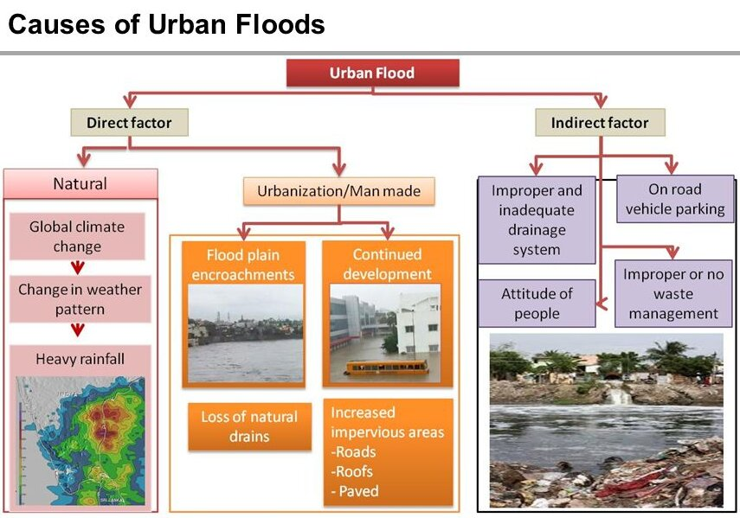

Slide 30
Who is responsible?
Government and public
he fact is that our cities have been built with little to no regard to the natural topography and severely lacks holistic action. Even with provisions of rainwater harvesting, sustainable urban drainage systems, etc, in regulatory mechanisms like the Environmental Impact Assessment (EIA), Notification 2006 or building bylaws of almost every state, adoption at user end as well as enforcement agencies remains weak.
Public bodies’ focus is largely on de-silting of storm water drains before monsoon and expansion of the over-burdened infrastructure, but at a crawling pace.
major factor is the city's old drainage system, which is heavily silted and damaged.
explosive growth in the urban population as well as infrastructure in the recent years.
As a result of poor planning, unregulated construction and mismanagement of environmental resources, water reservoirs and wetlands have vanished over the years.

Slide 31
What to do?
As the incidence of climate variability and extreme weather events increases, urban flooding becomes more and more common, it is inevitable that we look at the issue from a broad-based perspective.
Focus has to be on increasing the resilience of communities and adaptive capacity of our infrastructure.
Water sensitive urban design and planning techniques — especially in the context of implementation — are of utmost importance.
These methods take into consideration the topography, types of surfaces (pervious or impervious), natural drainage and leave very less impact on the environment. Vulnerability analyses and risk assessments should form part and parcel of city master plans.
In a changing climate, our proposed infrastructure (especially storm water drainage) has to be built considering the new ‘normals’. Tools such as predictive precipitation modelling can help do that and are also able to link it with the adaptive capacity of urban land use.
Most important is strong land use controls. EIAs and enforcement will remain vital to ensure that fragile wetlands and floodplains are not concretised.

Slide 32
What to do?
Need For Holistic Engagement: Urban floods of this scale cannot be contained by the municipal authorities alone. Floods cannot be managed without concerted and focused investments of energy and resources.
The Metropolitan Development Authorities, National Disaster Management Authority, State revenue and irrigation departments along with municipal corporations should be involved in such work together.
Such investments can only be done in a mission mode organisation with active participation of civil society organisations at the metropolitan scale.
Developing Sponge Cities: The idea of a sponge city is to make cities more permeable so as to hold and use the water which falls upon it.
Sponge cities absorb the rain water, which is then naturally filtered by the soil and allowed to reach urban aquifers.
This allows for the extraction of water from the ground through urban or peri-urban wells.This water can be treated easily and used for city water supply.
Wetland Policy: There is a need to start paying attention to the management of wetlands by involving local communities.
Without doubt, terrain alteration needs to be strictly regulated and a ban on any further alteration of terrain needs to be introduced.
To improve the city’s capacity to absorb water, new porous materials and technologies must be encouraged or mandated across scales.
Examples of these technologies are bioswales and retention systems, permeable material for roads and pavement, drainage systems which allow storm water to trickle into the ground, green roofs and harvesting systems in buildings.

Slide 33
Drainage Planning: Watershed management and emergency drainage plan should be clearly enunciated in policy and law.
Urban watersheds are micro ecological drainage systems, shaped by contours of terrain.
Detailed documentation of these must be held by agencies which are not bound by municipal jurisdictions; instead, there is a need to consider natural boundaries such as watersheds instead of governance boundaries like electoral wards for shaping a drainage plan.
Water Sensitive Urban Design: These methods take into consideration the topography, types of surfaces (permeable or impervious), natural drainage and leave very less impact on the environment.
Vulnerability analyses and risk assessments should form part and parcel of city master plans.In a changing climate, the drainage infrastructure (especially storm water drainage) has to be built considering the new ‘normals’.
Tools such as predictive precipitation modelling can help do that and are also able to link it with the adaptive capacity of urban land use.
Convergent Approach: These can all be delivered effectively through an urban mission along the lines of the Atal Mission for Rejuvenation and Urban Transformation (AMRUT), National Heritage City Development and Augmentation Yojana (HRIDAY) and Smart Cities Mission.

